Slide 1
CUSTOMER SEGMENTATION
GROUP ONE
PROJECT BY:
SURAJ DESHMUKH
RANJEET
BHANYTEJA
JESHMA
SHIVKUMAR
SHUBHAM

Slide 2
ABOUT PROJECT
Customer segmentation involves dividing a customer base into groups with similar characteristics or behaviors. This strategy enables businesses to personalize marketing efforts, improve customer experience, boost retention, and allocate resources more efficiently. Segmentation can be based on demographics, psychographics, behavior, or geography, and techniques like cluster analysis, RFM analysis, and machine learning algorithms are used. Despite challenges like data quality and overlapping segments, segmentation is a valuable tool for businesses to better understand and serve their customers.

Slide 3
WHAT IS CUSTOMER SEGMENTATION?
Customer Segmentation using Segmentation and Exploratory Data Analysis is a comprehensive study that leverages data-driven techniques to gain insights into consumer behavior and preferences.

Slide 4
OBJECTIVE
A case requires to develop a customer segmentation to give recommendations like type of products with respect to target customers groups.

Slide 5
OBJECTIVE
WHAT'S THEIR EDUCATION LEVEL?
ARE THEY MARRIED?
HOW MANY KIDS DO THEY HAVE?
WHAT'S THEIR INCOME LEVEL?
WHAT'S THEIR AGE?
FROM WHERE DO THEY BUY THE PRODUCTS?
HOW MUCH DO THEY SPEND ON DIFFERENT PRODUCTS?
FOR HOW LONG ARE THEY OUR CUSTOMERS?
DID THEY ACCEPT ANY OF OUR CAMPAIGNS?

Slide 6
ABOUT DATASET

Slide 7
ABOUT DATASET The sample Dataset summarizes the purchase behavior of about 2240 active customers. The file is at a customer level with 9 behavioral variables.
VARIABLES OF DATASET
EDUCATION
MARITAL STATUS
INCOME
KIDS
EXPENSE
TOTAL ACCEPTED CAMPAIGN
TOTAL PURCHASES
AGE
CUSTOMER FOR

Slide 8
PROJECT PROCESS

Slide 9
PROJECT PROCESS
Research and business understanding
The first thing you have to do before you solve a problem is to define exactly what it is. You need to be able to translate data questions into something actionable.
Data pre-processing
Data preprocessing can refer to manipulation or dropping of data before it is used in order to ensure or enhance performance, and is an important step in the data mining process.

Slide 10
Exploratory Data analysis
Exploratory data analysis is an approach of analyzing data sets to summarize their main characteristics, often using statistical graphics and other data visualization methods
Model Building
Model building process where different machine learning algorithms are used to make different machine learning models for various applications.
Model Deployment
Model Deployment is the process where various ML algorithms are deployed on various platforms like flask, Streamlit, various open source platforms, etc. Here we have used Streamlit to deploy our ML project.

Slide 11
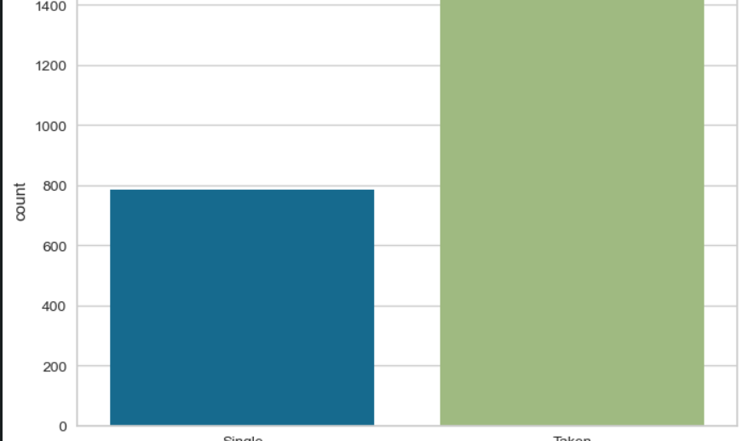
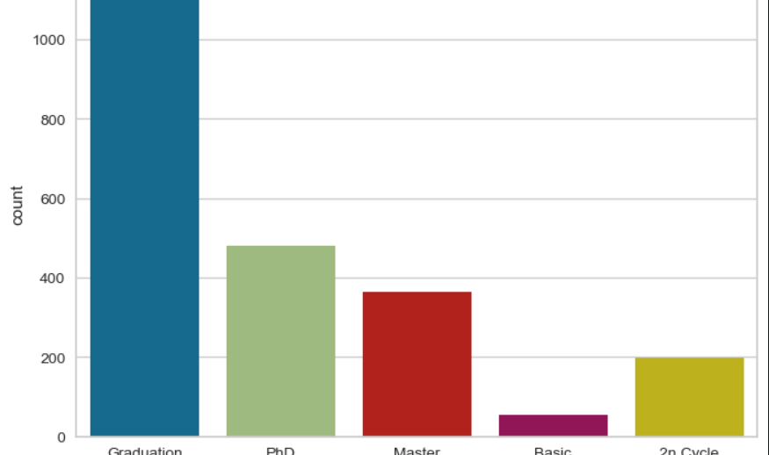
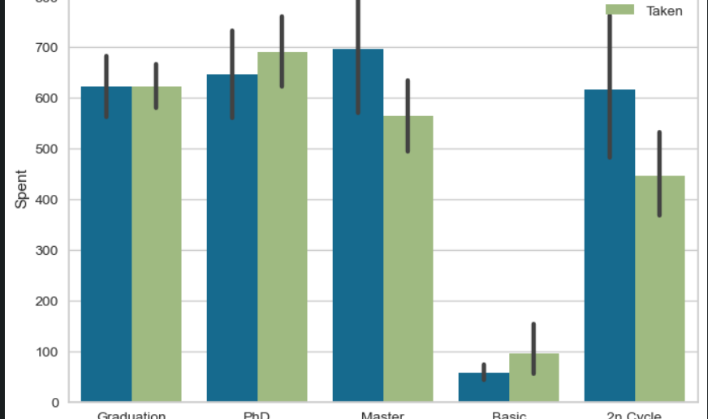
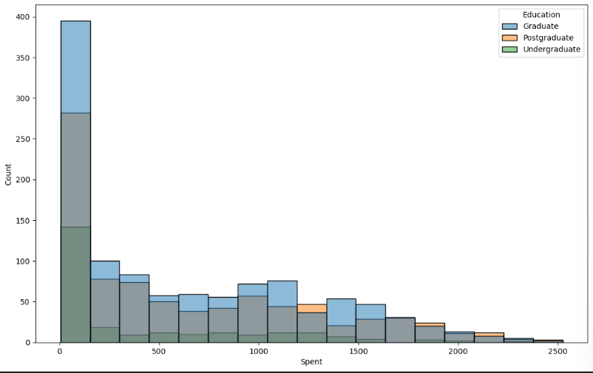
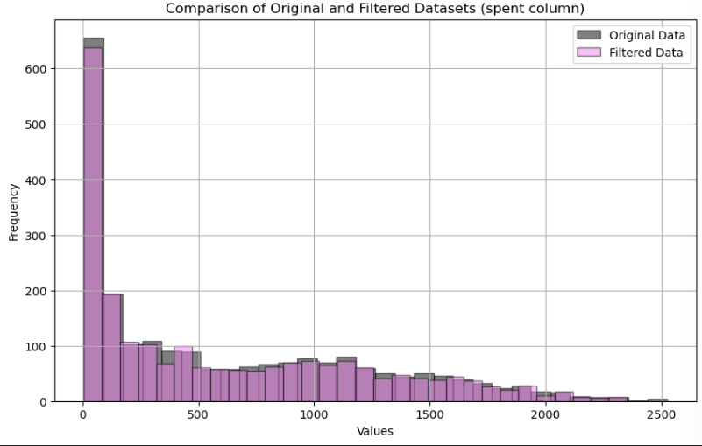
Exploratory Data Analysis

Slide 12
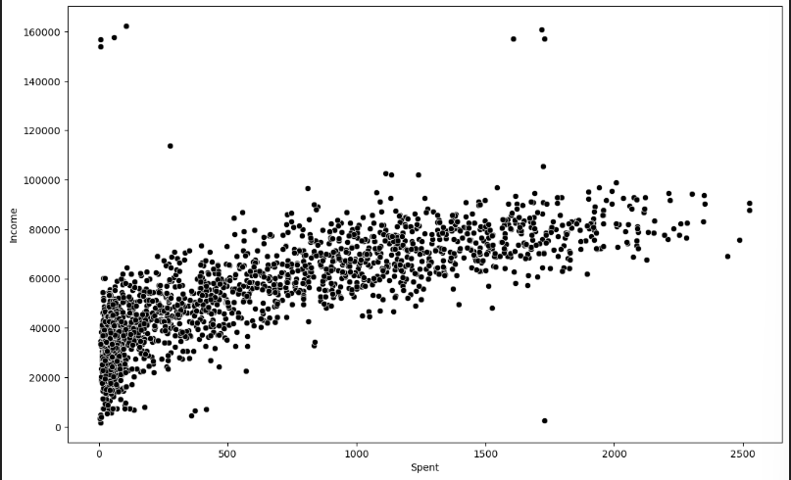
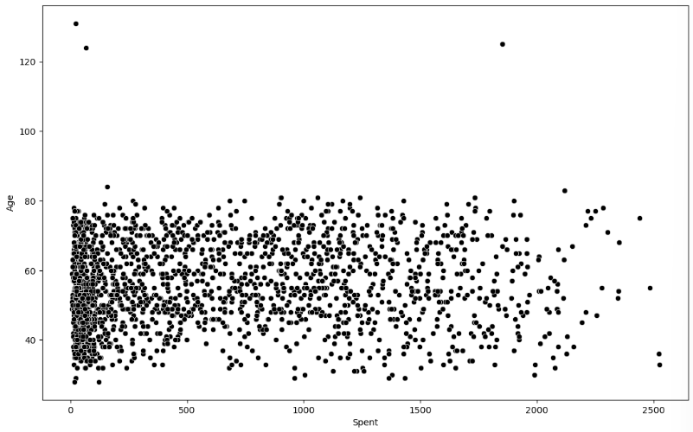
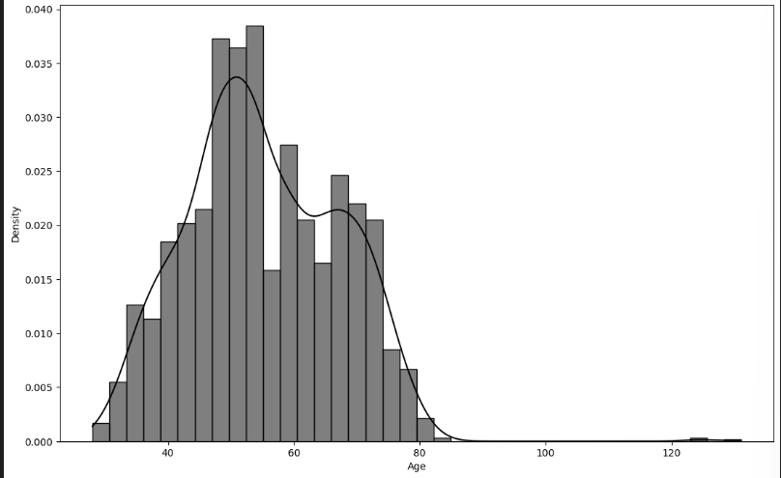
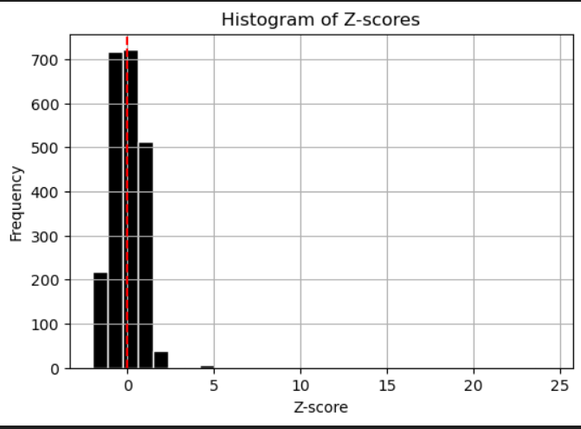
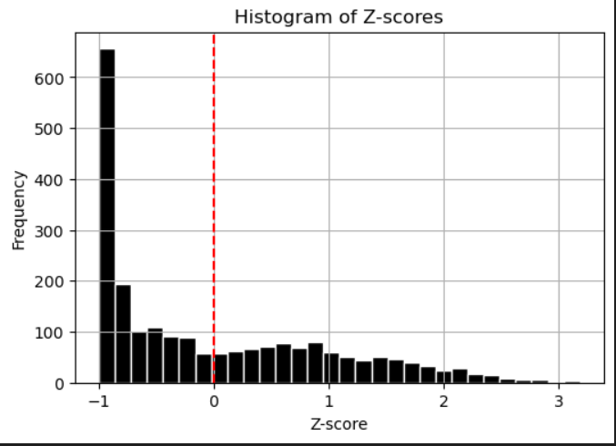
Exploratory Data Analysis

Slide 13
Algorithms used in the project
K-MEANS CLUSTERING
K NEAREST NEIGHBOUR
SUPPORT VECTOR CLASSIFIER
PRINCIPAL COMPONENT ANALYSIS
RANDOM FOREST

Slide 14
INSIGHTS GENERATED

Slide 15
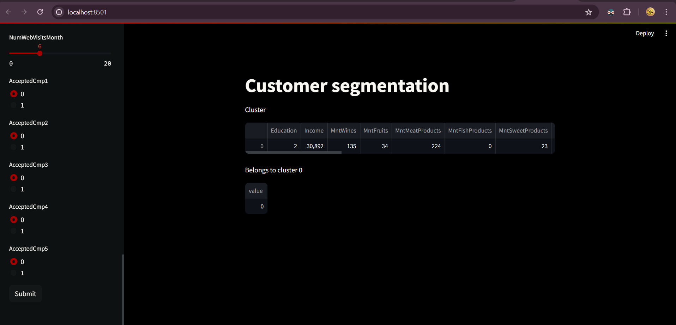
OUTPUT SCREEN

Slide 16
INPUT SCREEN
AGE : 29
EDUCATION : GRADUATION
RELATIONSHIP STATUS : SINGLE
CHILDREN : 0
INCOME : 30892
SPENT : 441
WINES: 135
FRUITS: 34
MEAT PRODUCTS : 224
SWEET : 23
NUMWEBPURCHASES : 4
NUMWEBVISITSMONTH : 6

Slide 17
CHALLENGES
Overfitting issue of accuracy 100%.
Because, number of clusters has taken wrongly as 2.
Deployment was quite challenging.
The errors while doing deployment were complicated each time while recovering one line.
Got errors of file paths and directory structures during deployment.
Dependencies required were not installed properly, so it was a huge task in the deployment environment, because of which our deployment was not working.

Slide 18
THANK YOU

